Slide 1


CS 188: Artificial Intelligence
Constraint Satisfaction Problems
Instructors: Dan Klein and Pieter Abbeel
University of California, Berkeley
[These slides were created by Dan Klein and Pieter Abbeel for CS188 Intro to AI at UC Berkeley. All CS188 materials are available at http://ai.berkeley.edu.]
Notes:
Please retain proper attribution, including the reference to ai.berkeley.edu. Thanks!

Slide 2
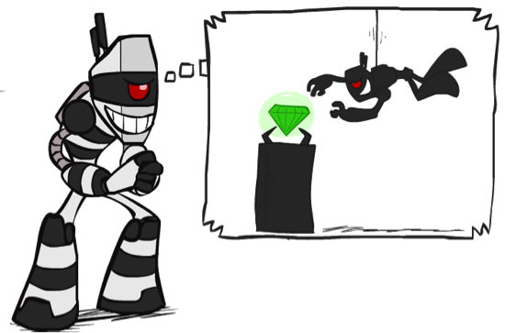

What is Search For?
Assumptions about the world: a single agent, deterministic actions, fully observed state, discrete state space
Planning: sequences of actions
The path to the goal is the important thing
Paths have various costs, depths
Heuristics give problem-specific guidance
Identification: assignments to variables
The goal itself is important, not the path
All paths at the same depth (for some formulations)
CSPs are specialized for identification problems

Slide 3

Constraint Satisfaction Problems

Slide 4


Constraint Satisfaction Problems
Standard search problems:
State is a “black box”: arbitrary data structure
Goal test can be any function over states
Successor function can also be anything
Constraint satisfaction problems (CSPs):
A special subset of search problems
State is defined by variables X_{i} with values from a domain D (sometimes D depends on i)
Goal test is a set of constraints specifying allowable combinations of values for subsets of variables
Simple example of a formal representation language
Allows useful general-purpose algorithms with more power than standard search algorithms
Notes:
Goal test has structure, it ‘s more like a manual describing a set of constraints that have to hold true

Slide 5
CSP Examples

Slide 6


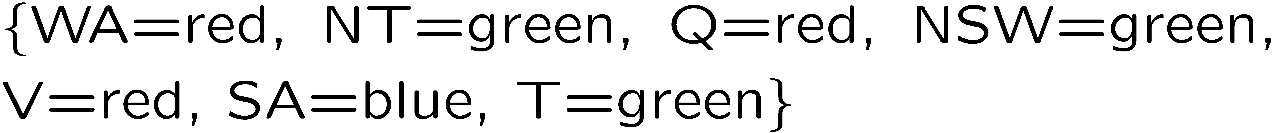
Example: Map Coloring
Variables:
Domains:
Constraints: adjacent regions must have different colors
Solutions are assignments satisfying all constraints, e.g.:
Implicit:
Explicit:

Slide 7
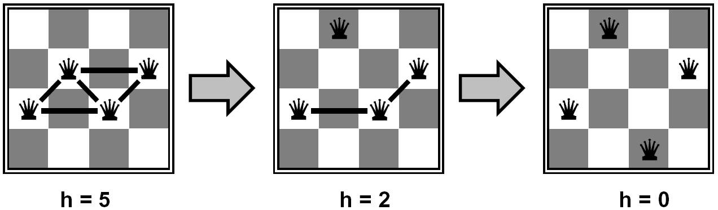

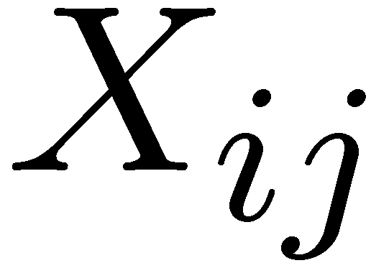

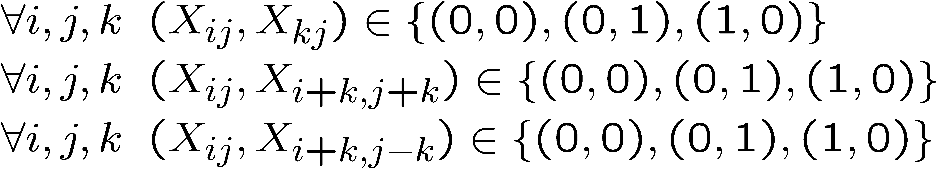
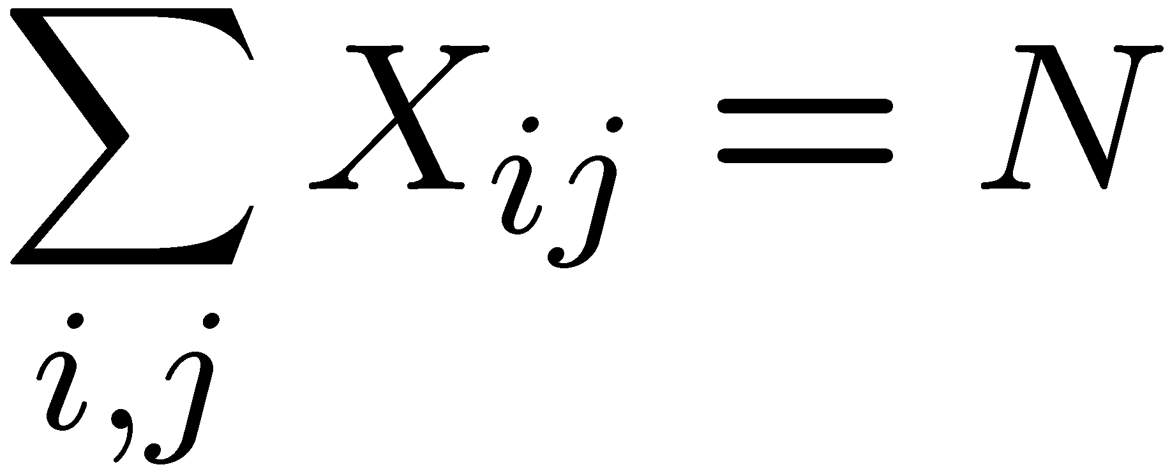
Example: N-Queens
Formulation 1:
Variables:
Domains:
Constraints

Slide 8







Example: N-Queens
Formulation 2:
Variables:
Domains:
Constraints:
Implicit:
Explicit:

Slide 9
Constraint Graphs

Slide 10
Constraint Graphs
Binary CSP: each constraint relates (at most) two variables
Binary constraint graph: nodes are variables, arcs show constraints
General-purpose CSP algorithms use the graph structure to speed up search. E.g., Tasmania is an independent subproblem!
[Demo: CSP applet (made available by aispace.org) -- n-queens]
Notes:
Demo:
Run constraint.jar or constraint.exe, load the 5 queens problem.
Demo is just showing the n-queens applet as illustration of constraint graph, but later in lecture we’ll interact with the applet.
aispace.org will have the latest version

Slide 11
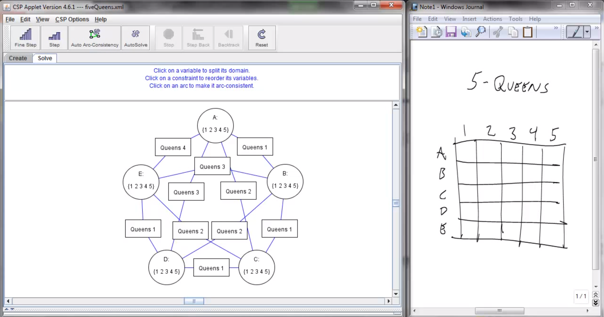
Screenshot of Demo N-Queens
Notes:
Note: the n-queens demo is used later as a demo; at this stage in lecture just the above is shown and talked about without engaging in any interaction with the applet.

Slide 12


Example: Cryptarithmetic
Variables:
Domains:
Constraints:
Notes:
0=7, R=4, W=6, U=2, T=8, F=1; 867 + 867 = 1734

Slide 13
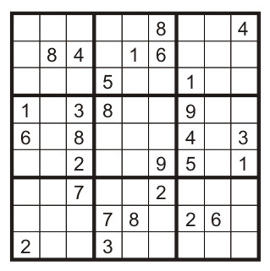
Example: Sudoku
Variables:
Each (open) square
Domains:
{1,2,…,9}
Constraints:
9-way alldiff for each column
9-way alldiff for each row
9-way alldiff for each region
(or can have a bunch of pairwise inequality constraints)

Slide 14
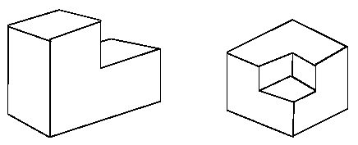
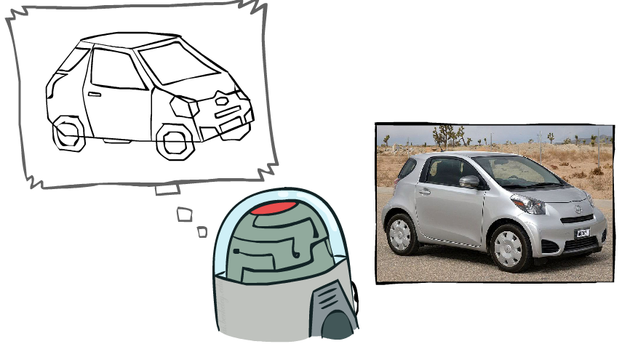
Example: The Waltz Algorithm
The Waltz algorithm is for interpreting line drawings of solid polyhedra as 3D objects
An early example of an AI computation posed as a CSP
?
Approach:
Each intersection is a variable
Adjacent intersections impose constraints on each other
Solutions are physically realizable 3D interpretations

Slide 15


Example: The Waltz Algorithm
The Waltz algorithm is for interpreting line drawings of solid polyhedra as 3D objects
An early example of an AI computation posed as a CSP
?
Approach:
Each intersection is a variable
Adjacent intersections impose constraints on each other
Solutions are physically realizable 3D interpretations

Slide 16

Varieties of CSPs and Constraints

Slide 17


Varieties of CSPs
Discrete Variables
Finite domains
Size d means O(d^{n}) complete assignments
E.g., Boolean CSPs, including Boolean satisfiability (NP-complete)
Infinite domains (integers, strings, etc.)
E.g., job scheduling, variables are start/end times for each job
Linear constraints solvable, nonlinear undecidable
Continuous variables
E.g., start/end times for Hubble Telescope observations
Linear constraints solvable in polynomial time by LP methods (see cs170 for a bit of this theory)

Slide 18


Varieties of Constraints
Varieties of Constraints
Unary constraints involve a single variable (equivalent to reducing domains), e.g.:
Binary constraints involve pairs of variables, e.g.:
Higher-order constraints involve 3 or more variables:
e.g., cryptarithmetic column constraints
Preferences (soft constraints):
E.g., red is better than green
Often representable by a cost for each variable assignment
Gives constrained optimization problems
(We’ll ignore these until we get to Bayes’ nets)

Slide 19
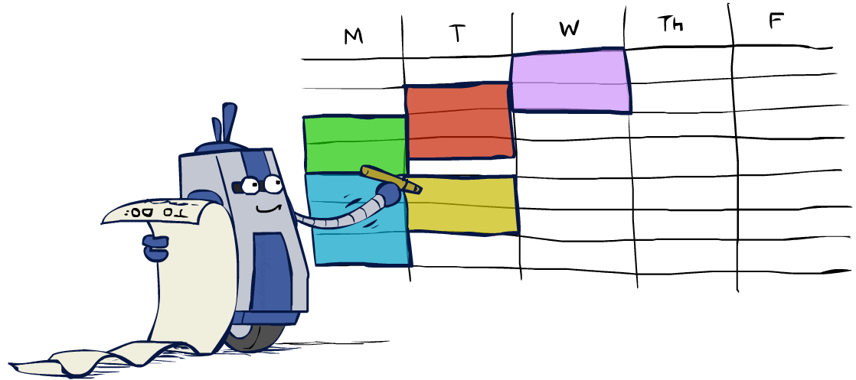
Real-World CSPs
Assignment problems: e.g., who teaches what class
Timetabling problems: e.g., which class is offered when and where?
Hardware configuration
Transportation scheduling
Factory scheduling
Circuit layout
Fault diagnosis
… lots more!
Many real-world problems involve real-valued variables…

Slide 20

Solving CSPs

Slide 21
Standard Search Formulation
Standard search formulation of CSPs
States defined by the values assigned so far (partial assignments)
Initial state: the empty assignment, {}
Successor function: assign a value to an unassigned variable
Goal test: the current assignment is complete and satisfies all constraints
We’ll start with the straightforward, naïve approach, then improve it

Slide 22
Search Methods
What would BFS do?
What would DFS do?
What problems does naïve search have?
[Demo: coloring -- dfs]
Notes:
Demo:
CS188 javascript demos -> source -> exercises -> csps -> CSPs demos -> CSPs demos.html
Settings:
Graph = Simple
Algorithm = Naïve Search
Ordering = None
Filtering = None

Slide 23

Video of Demo Coloring -- DFS

Slide 24

Backtracking Search

Slide 25
Backtracking Search
Backtracking search is the basic uninformed algorithm for solving CSPs
Idea 1: One variable at a time
Variable assignments are commutative, so fix ordering
I.e., [WA = red then NT = green] same as [NT = green then WA = red]
Only need to consider assignments to a single variable at each step
Idea 2: Check constraints as you go
I.e. consider only values which do not conflict previous assignments
Might have to do some computation to check the constraints
“Incremental goal test”
Depth-first search with these two improvements
is called backtracking search (not the best name)
Can solve n-queens for n ≈ 25

Slide 26
Backtracking Example

Slide 27
Backtracking Search
Backtracking = DFS + variable-ordering + fail-on-violation
What are the choice points?
[Demo: coloring -- backtracking]
Notes:
Demo:
CS188 javascript demos -> source -> exercises -> csps -> CSPs demos -> CSPs demos.html
Settings:
Graph = Simple
Algorithm = Backtracking
Ordering = None
Filtering = None

Slide 28
Video of Demo Coloring – Backtracking

Slide 29

Improving Backtracking
General-purpose ideas give huge gains in speed
Ordering:
Which variable should be assigned next?
In what order should its values be tried?
Filtering: Can we detect inevitable failure early?
Structure: Can we exploit the problem structure?

Slide 30

Filtering

Slide 31
Filtering: Forward Checking
Filtering: Keep track of domains for unassigned variables and cross off bad options
Forward checking: Cross off values that violate a constraint when added to the existing assignment
WA
NT
Q
SA
NSW
V
[Demo: coloring -- forward checking]
Notes:
Demo:
CS188 javascript demos -> source -> exercises -> csps -> CSPs demos -> CSPs demos.html
Settings:
Graph = Simple
Algorithm = Backtracking
Ordering = None
Filtering = Forward Checking

Slide 32
Video of Demo Coloring – Backtracking with Forward Checking

Slide 33
Filtering: Constraint Propagation
Forward checking propagates information from assigned to unassigned variables, but doesn't provide early detection for all failures:
NT and SA cannot both be blue!
Why didn’t we detect this yet?
Constraint propagation: reason from constraint to constraint
NT
Q
WA
SA
NSW
V

Slide 34

Consistency of A Single Arc
An arc X → Y is consistent iff for every x in the tail there is some y in the head which could be assigned without violating a constraint
Forward checking: Enforcing consistency of arcs pointing to each new assignment
NT
Q
WA
SA
NSW
V
Delete from the tail!

Slide 35
Arc Consistency of an Entire CSP
A simple form of propagation makes sure all arcs are consistent:
Important: If X loses a value, neighbors of X need to be rechecked!
Arc consistency detects failure earlier than forward checking
Can be run as a preprocessor or after each assignment
What’s the downside of enforcing arc consistency?
NT
Q
WA
SA
NSW
V
Remember: Delete from the tail!

Slide 36
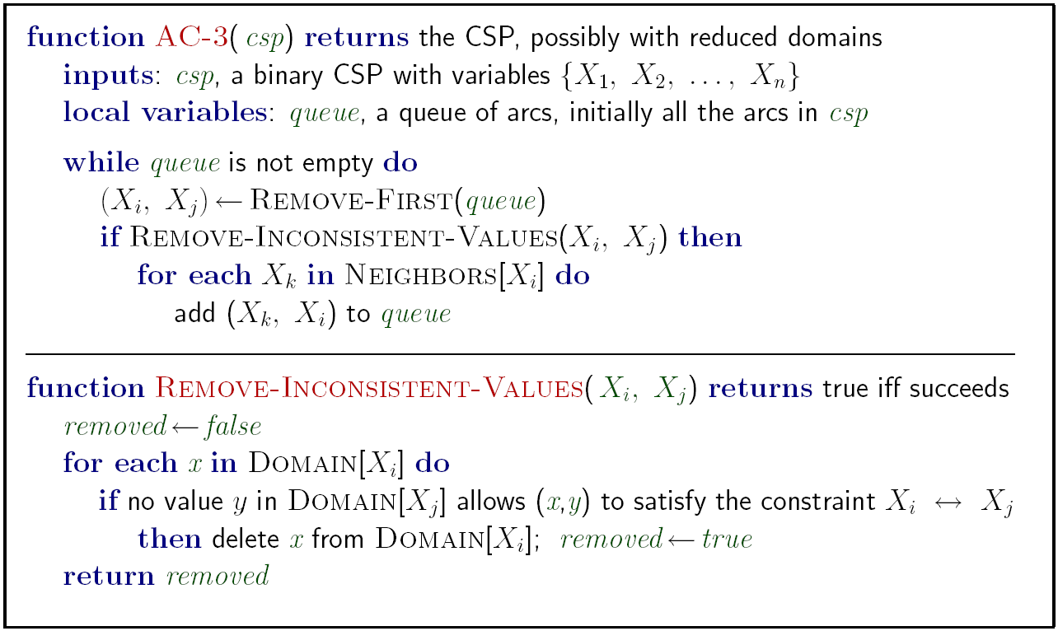
Enforcing Arc Consistency in a CSP
Runtime: O(n²d³), can be reduced to O(n²d²)
… but detecting all possible future problems is NP-hard – why?
[Demo: CSP applet (made available by aispace.org) -- n-queens]
Notes:
Auto-consistency (note initially nothing gets deleted/pruned since there are consistent options for all constraints for initial variable domains)
Flashes whenever something needs to be re-checked

Slide 37
Video of Demo Arc Consistency – CSP Applet – n Queens

Slide 38
Limitations of Arc Consistency
After enforcing arc consistency:
Can have one solution left
Can have multiple solutions left
Can have no solutions left (and not know it)
Arc consistency still runs inside a backtracking search!
What went wrong here?
[Demo: coloring -- forward checking]
[Demo: coloring -- arc consistency]
Notes:
Demo:
CS188 javascript demos -> source -> exercises -> csps -> CSPs demos -> CSPs demos.html
Settings:
Graph = Complex
Algorithm = Backtracking
Ordering = None
Filtering = Forward Checking (first) / Arc Consistency (second)

Slide 39
Video of Demo Coloring – Backtracking with Forward Checking – Complex Graph

Slide 40
Video of Demo Coloring – Backtracking with Arc Consistency – Complex Graph

Slide 41

Ordering

Slide 42
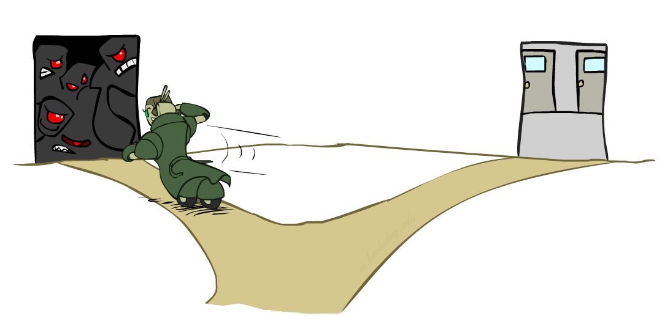
Ordering: Minimum Remaining Values
Variable Ordering: Minimum remaining values (MRV):
Choose the variable with the fewest legal left values in its domain
Why min rather than max?
Also called “most constrained variable”
“Fail-fast” ordering

Slide 43
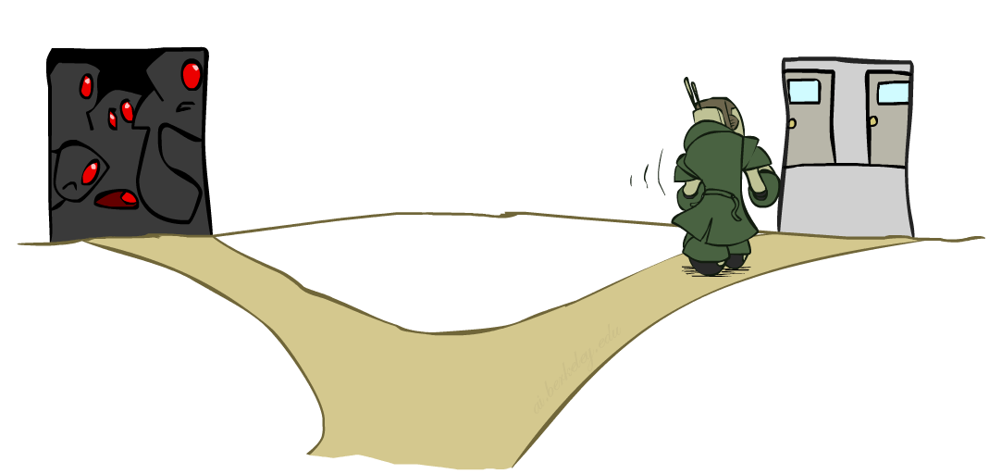
Ordering: Least Constraining Value
Value Ordering: Least Constraining Value
Given a choice of variable, choose the least constraining value
I.e., the one that rules out the fewest values in the remaining variables
Note that it may take some computation to determine this! (E.g., rerunning filtering)
Why least rather than most?
Combining these ordering ideas makes
1000 queens feasible

Slide 44
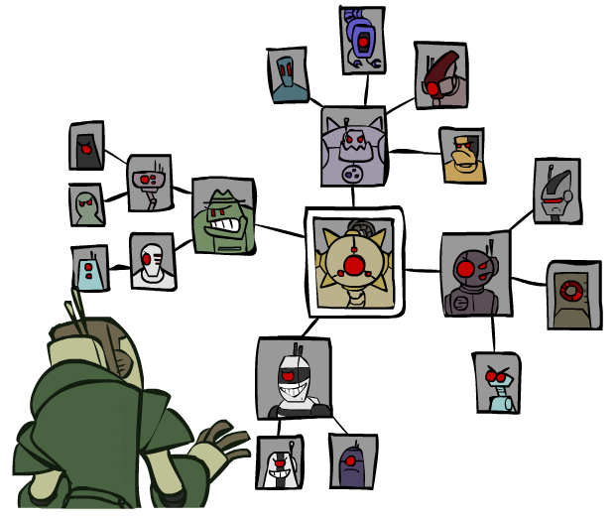
Structure

Slide 45
Problem Structure
Extreme case: independent subproblems
Example: Tasmania and mainland do not interact
Independent subproblems are identifiable as connected components of constraint graph
Suppose a graph of n variables can be broken into subproblems of only c variables:
Worst-case solution cost is O((n/c)(d^{c})), linear in n
E.g., n = 80, d = 2, c =20
2⁸⁰ = 4 billion years at 10 million nodes/sec
(4)(2²⁰) = 0.4 seconds at 10 million nodes/sec

Slide 46
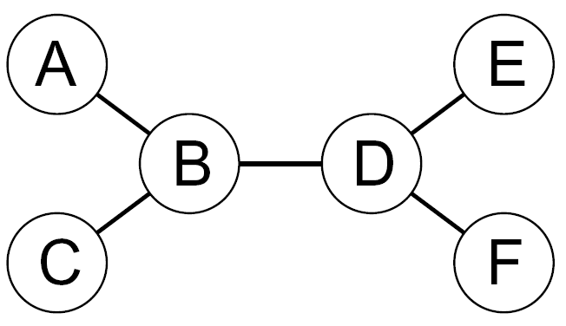
Tree-Structured CSPs
Theorem: if the constraint graph has no loops, the CSP can be solved in O(n d²) time
Compare to general CSPs, where worst-case time is O(d^{n})
This property also applies to probabilistic reasoning (later): an example of the relation between syntactic restrictions and the complexity of reasoning

Slide 47
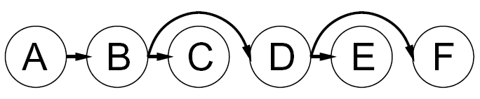


Tree-Structured CSPs
Algorithm for tree-structured CSPs:
Order: Choose a root variable, order variables so that parents precede children
Remove backward: For i = n : 2, apply RemoveInconsistent(Parent(X_{i}),X_{i})
Assign forward: For i = 1 : n, assign X_{i} consistently with Parent(X_{i})
Runtime: O(n d²) (why?)

Slide 48
Tree-Structured CSPs
Claim 1: After backward pass, all root-to-leaf arcs are consistent
Proof: Each X→Y was made consistent at one point and Y’s domain could not have been reduced thereafter (because Y’s children were processed before Y)
Claim 2: If root-to-leaf arcs are consistent, forward assignment will not backtrack
Proof: Induction on position
Why doesn’t this algorithm work with cycles in the constraint graph?
Note: we’ll see this basic idea again with Bayes’ nets

Slide 49
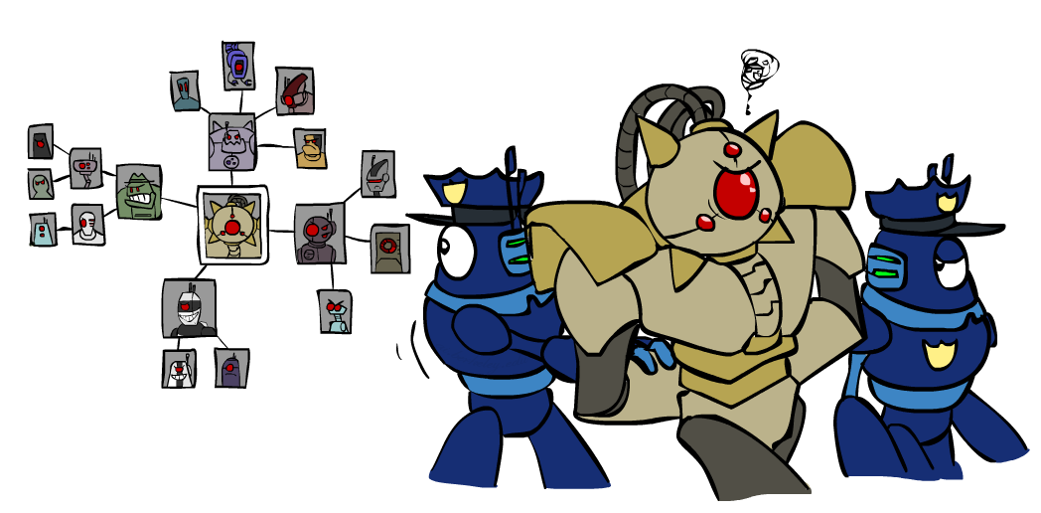
Improving Structure

Slide 50
Nearly Tree-Structured CSPs
Conditioning: instantiate a variable, prune its neighbors' domains
Cutset conditioning: instantiate (in all ways) a set of variables such that the remaining constraint graph is a tree
Cutset size c gives runtime O( (d^{c}) (n-c) d² ), very fast for small c

Slide 51
Cutset Conditioning
Choose a cutset
SA
Instantiate the cutset (all possible ways)
SA
SA
SA
Compute residual CSP for each assignment
Solve the residual CSPs (tree structured)

Slide 52
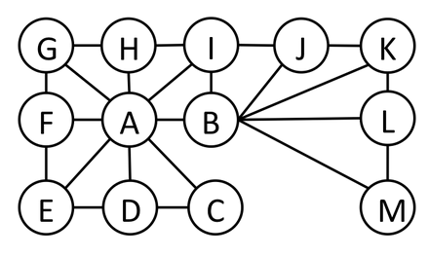
Cutset Quiz
Find the smallest cutset for the graph below.

Slide 53
Tree Decomposition*
Idea: create a tree-structured graph of mega-variables
Each mega-variable encodes part of the original CSP
Subproblems overlap to ensure consistent solutions
M1
M2
M3
M4
WA
≠
NT
NT
≠
Q
Q
≠
NSW
NSW
≠
V
≠
≠
≠
≠
≠
≠
≠
≠
SA
SA
SA
SA
Agree on shared vars
Agree on shared vars
Agree on shared vars
{(WA=r,SA=g,NT=b),
(WA=b,SA=r,NT=g),
…}
{(NT=r,SA=g,Q=b),
(NT=b,SA=g,Q=r),
…}
Agree: (M1,M2) ∈
{((WA=g,SA=g,NT=g), (NT=g,SA=g,Q=g)), …}

Slide 54
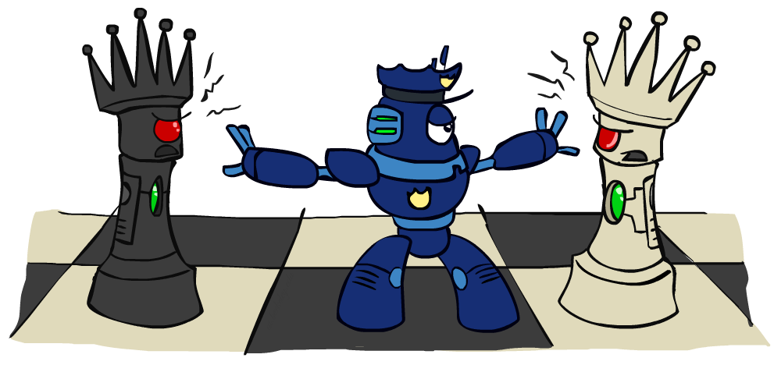
Iterative Improvement

Slide 55
Iterative Algorithms for CSPs
Local search methods typically work with “complete” states, i.e., all variables assigned
To apply to CSPs:
Take an assignment with unsatisfied constraints
Operators reassign variable values
No fringe! Live on the edge.
Algorithm: While not solved,
Variable selection: randomly select any conflicted variable
Value selection: min-conflicts heuristic:
Choose a value that violates the fewest constraints
I.e., hill climb with h(n) = total number of violated constraints

Slide 56
Example: 4-Queens
States: 4 queens in 4 columns (4⁴ = 256 states)
Operators: move queen in column
Goal test: no attacks
Evaluation: c(n) = number of attacks
[Demo: n-queens – iterative improvement (L5D1)]
[Demo: coloring – iterative improvement]
Notes:
L5D1 – python demos
Coloring – javascript demos

Slide 57
Video of Demo Iterative Improvement – n Queens

Slide 58
Video of Demo Iterative Improvement – Coloring

Slide 59
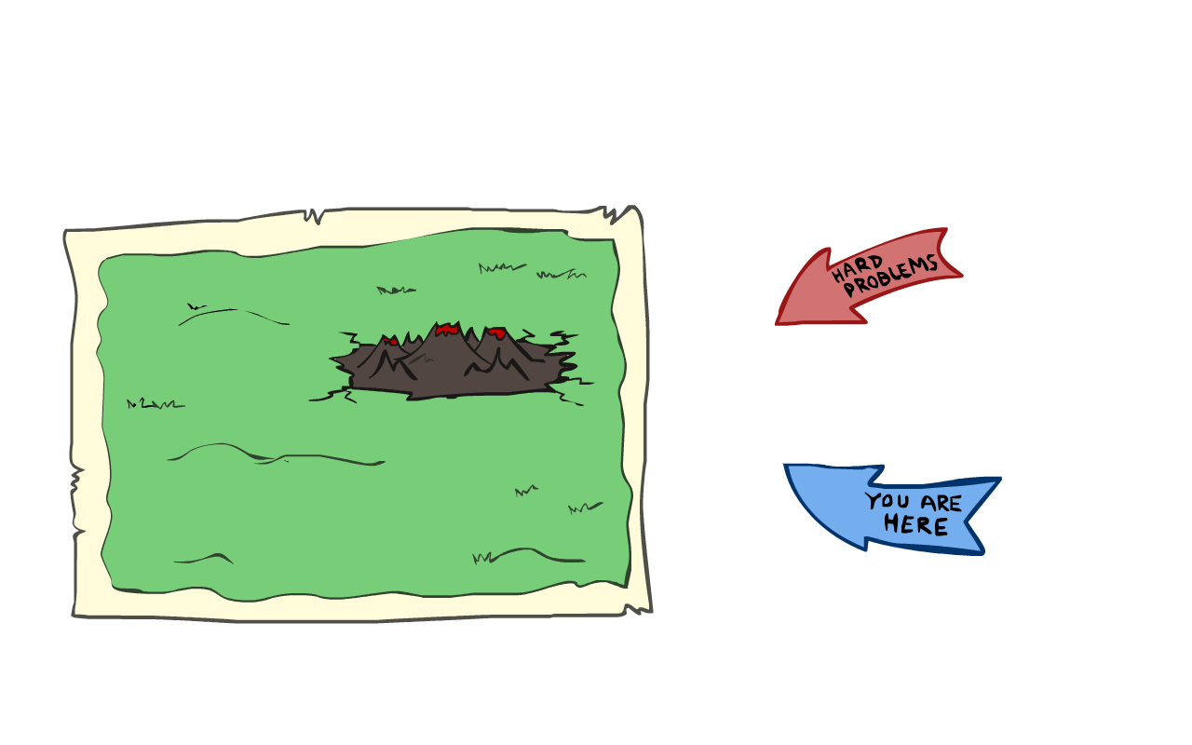

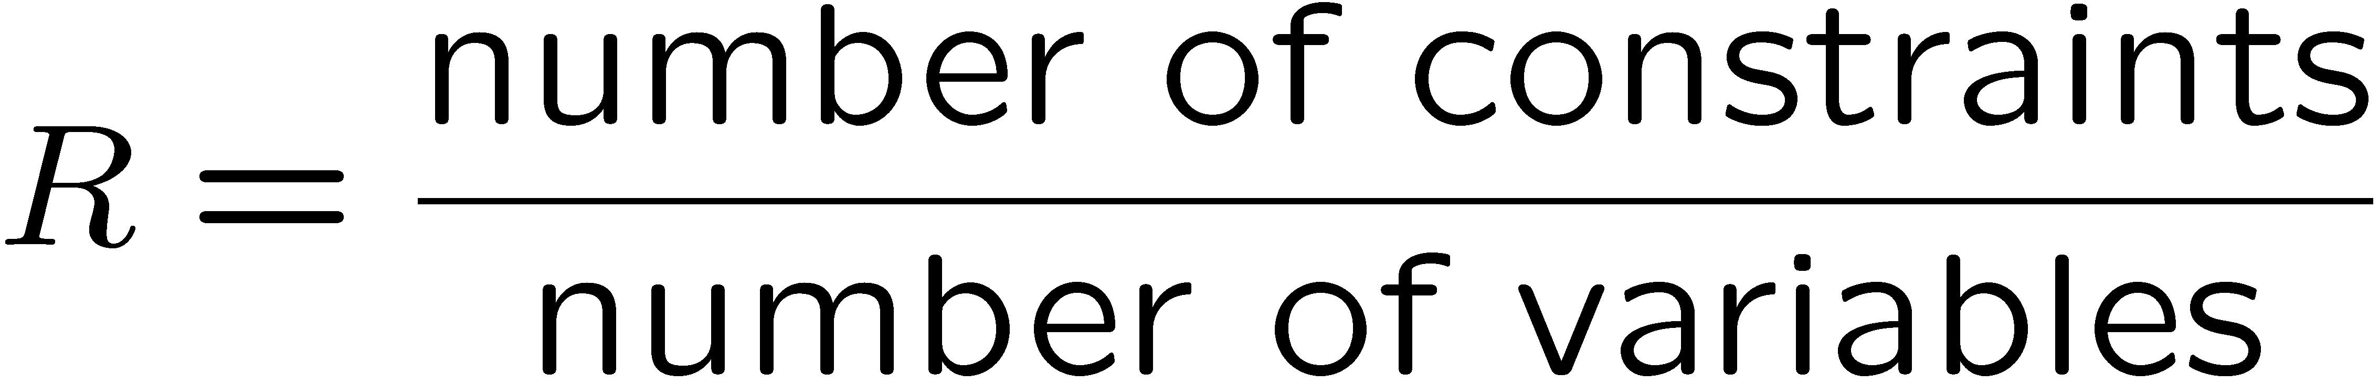
Performance of Min-Conflicts
Given random initial state, can solve n-queens in almost constant time for arbitrary n with high probability (e.g., n = 10,000,000)!
The same appears to be true for any randomly-generated CSP except in a narrow range of the ratio

Slide 60
Summary: CSPs
CSPs are a special kind of search problem:
States are partial assignments
Goal test defined by constraints
Basic solution: backtracking search
Speed-ups:
Ordering
Filtering
Structure
Iterative min-conflicts is often effective in practice

